Slide 1
DENGUE IN SINGAPORE
Group 2
Members: Shin, Jason, Cindy, Chun Shan

Slide 2
ABOUT THE PROBLEM
You just graduated from General Assembly Data Science Immersive program and managed to secure an interview with the National environmental Agency (NEA). You have been assigned into a group with other interviewees and was given a take home BI test. You will be required to work together and present as a group during the interview. Time to look at the test!
Dengue fever [https://www.healthhub.sg/a-z/diseases-and-conditions/192/topic_dengue_fever_MOH] is spread though the bite of the Aedes mosquito. To prevent dengue fever, one must prevent the breeding of the Aedes mosquitoes. Aedes mosquitoes are identified by the black and white stripes on their bodies. It prefers to breed in clean, stagnant water easily found in our homes. You can get rid of the Aedes mosquito by frequently checking and removing stagnant water in your premises. The NEA has a stringent B-L-O-C-K STOP Dengue Now campaign.
In this exercise, you are required to predict Dengue Cases in Singapore. You will be using the following potential predictors for dengue:
Weather information: Rainfall and temperature patterns are one of the main drivers of dengue transmission as mosquitoes require standing water to reproduce
Google trends: Search terms containing the term ‘dengue’ have been successfully used to predict dengue cases in a number of countries. This is probably because those who are more susceptible to the virus, are also more likely to be googling about it.
Dataset
You will have to curate your dataset from
http://www.weather.gov.sg/climate-historical-daily/
https://data.gov.sg/dataset/weekly-number-of-dengue-and-dengue-haemorrhagic-fever-cases (Currently has weekly number of cases from 2014 to 2018)
https://trends.google.com/trends/explore?date=today%205-y&geo=SG&q=%2Fm%2F09wsg
Navigating Group Work
This project will be executed as a group. To make your team as effective and efficient as possible you should do the create a shared GitHub repo and project planning document as described in the deliverables section below.
We are .

Slide 3
ABOUT THE PROBLEM
GitHub Repo
Retrieve the dataset and upload it into a directory named assets.
Generate a .py or .ipynb file that imports the available data.
Project Planning
Define your deliverable - what is the end result?
Create a GitHub repository for the group. Each member should be added as a contributor.
Break that deliverable up into its components, and then organize them into actionable items. Document these using a project management tool to track things getting done. The tool you use is up to you; it could be Trello, a spreadsheet, GitHub issues, etc.
Begin deciding priorities for each task. These are subject to change, but it's good to get an initial consensus. Order these priorities however you would like.
You planning documentation (or a link to it) should be included in your GitHub repo.
EDA
Describe the data. What does it represent? What types are present? What does each data points' distribution look like? Discuss these questions, and your own, with your partners. Document your conclusions.
What kind of cleaning is needed? Document any potential issues that will need to be resolved.
Note: As you know, EDA is the single most important part of data science. This is where you should be spending most of your time. Knowing your data, and understanding the status of its integrity, is what makes or breaks a project.
We are .

Slide 4
ABOUT THE PROBLEM
Modeling
The goal is of course to build a model and make predictions that NEA can use when it decides where to spray pesticides! Your team should have a clean Jupyter Notebook that shows your EDA process, your modeling and predictions.
Conduct a cost-benefit analysis. This should include annual cost projections for various levels of pesticide coverage (cost) and the effect of these various levels of pesticide coverage (benefit). (Hint: How would we quantify the benefit of pesticide spraying? To get "maximum benefit," what does that look like and how much does that cost? What if we cover less and therefore get a lower level of benefit?)
Your final submission should be in your GitHub repo.
Resume
Prepare your resume. Include in that you have completed General Assembly Data Science Immersive course as part of your education section. Each member should have their individual resume in doc/pdf format.
You can create a folder called 'resume' to keep your resumes.
You will be asked questions during the presentation based on your resume.
Presentation
Audience: You are presenting to interviewers from the data science department. Some members of the audience will be data scientists, biostatisticians and epidemiologists who will understand your models and metrics and will want more information. Others will be decision-makers, focusing almost exclusively on your cost-benefit analysis. Your job as a group is to convince both groups of the best course of action in the same meeting and be able to answer questions that either group may ask.
The length of your interview should be about 20 minutes (a rough guideline: 1 minute intro, 5 minutes on model, 2 minutes on cost-benefit analysis, 2 minute recommendations/conclusion, 10 minute QnA).
We are .

Slide 5
ABOUT THE PROBLEM
Cindy, Shin, Chun Shan and Jason graduated from General Assembly Data Science Immersive program and managed to secure an interview with the National environmental Agency (NEA). They have been assigned into a group with other interviewees and was given a take home BI test.

Slide 6
PROBLEM
Problem Statement
Deliverables
We are tasked to predict the number of dengue cases based on data from Singapore Weather Station and Public Interest in dengue.
1 main model that can help to predict number of dengue cases
A tool for NEA officers, public health experts and pest control companies to gauge the optimal resources to invest in dengue prevention methods
Target Audience
NEA to contract company representatives from pest control companies
Dataset
- Historical daily weather data from weather.gov.sg
- google trend data of search words related to dengue
- Dengue and other diseases data from MOH through weekly infectious diseases bulletin
- Location-based Dengue Cases data through SGCharts: Outbreak
Cost
Prevention Cost
Remedy Cost
Social / Individual Cost

Slide 7

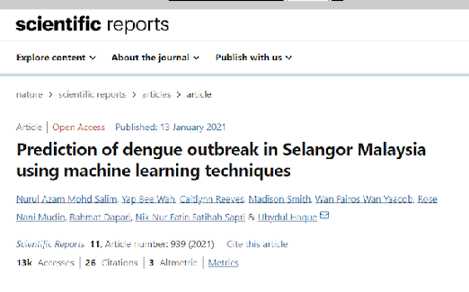
LITERATURE REVIEW
Dengue in China
Dengue in Selangor, Malaysia
Top factors for prediction: The week-of-the-year was the most important predictor in the SVM model.
Methodology: Climate variables such as temperature, wind speed, humidity and rainfall were used in each model. Based on results, the SVM (linear kernel) exhibited the best prediction performance (Accuracy= 70%, Sensitivity = 14%, Specifcity = 95%, Precision= 56%). However, the sensitivity for SVM (linear) for the testing sample increased up to 63.54% compared to 14.4% for imbalanced data (original data).
Top 3 factors for dengue occurrence in Xishuangbanna:
monthly average of minimum temperature
monthly average of maximum temperature
monthly average of relative humidity

Slide 8
TYPES OF COSTS

Slide 9
Cost of Dengue
Increase ‘Prevention’ to Reduce ‘Remedy Cost’ and ‘Social / Individual Cost’
Prevention Cost
Remedy Cost
Social / Individual Cost
Public Campaign
Anti-mosquito fogging and oiling
Project Wolbachia
Site and Home Inspection
Dengue prediction
Media Coverage
Anti-mosquito fogging and oiling
Dengue Hotspot Inspection
Warding severe cases
Disability-adjusted life years
Mosquito Repellent

Slide 10
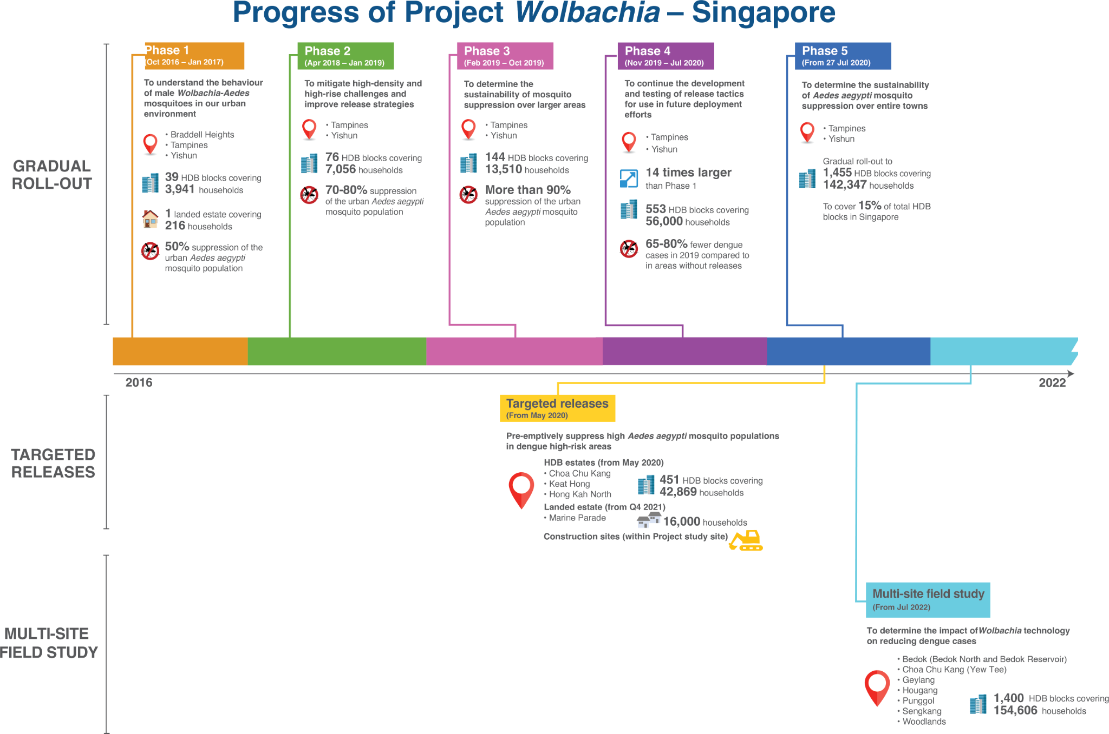
PROJECT WOLBACHIA
Wolbachia suppression program in Singapore
Male Wolbachia-Aedes mosquitoes will be released around residential blocks and along common corridors. They will not be released in homes. Releases will be conducted twice a week, as indicated in the schedule below. This schedule is subject to changes (e.g. due to public holidays).
We conservatively estimate that Wolbachia would cost an estimated $50,453–$100,907 per DALYs averted and would lead to an estimated $329.40 Million saved in economic costs over 2010 to 2020 under 40% intervention efficacy.

Slide 11
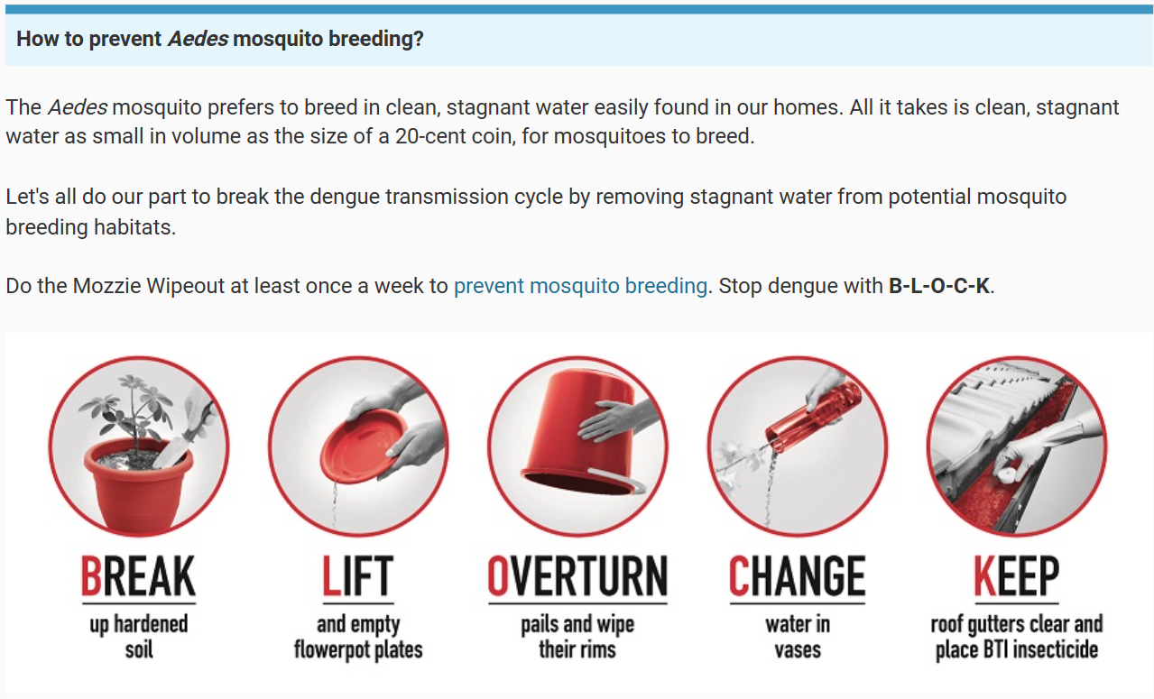
5 STEP MOZZIE WIPEOUT B-L-O-C-K STRATEGY

Slide 12
COST OF DENGUE BLOOD TEST IN SG
How much is dengue blood test for diagnosis and is it necessary?
PQ response: Before Government subsidy, a dengue blood test could cost about $70 - $80 at a General Practitioner (GP) clinic, and about $50 - $60 at a polyclinic.
https://www.moh.gov.sg/news-highlights/details/difference-in-cost-of-testing-for-dengue-fever-at-chas-clinics-polyclinics-and-private-clinics/

Slide 13
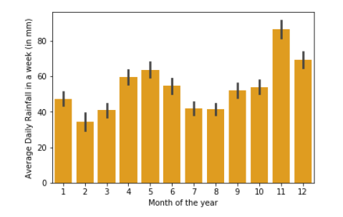
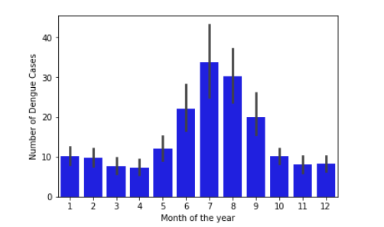
EDA - Dengue cases vs Daily Rainfall

Slide 14
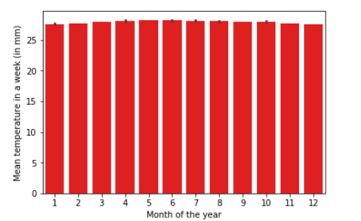
EDA - Dengue cases vs Mean Temperatures

Slide 15
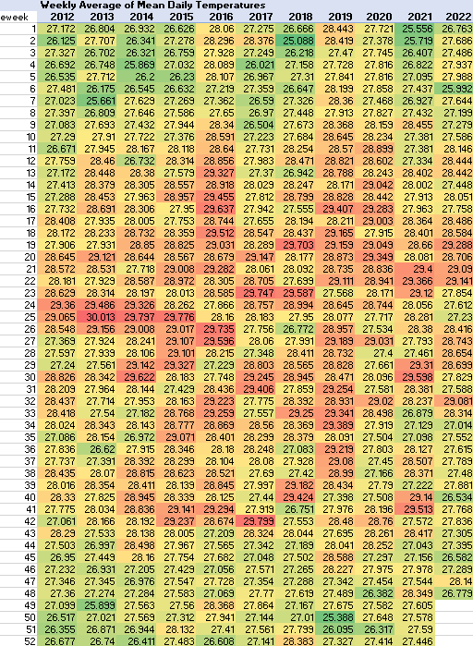
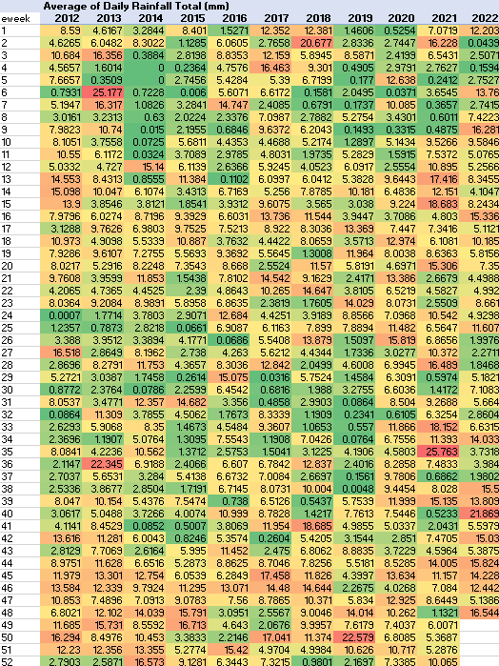
EDA - Heat Maps

Slide 16
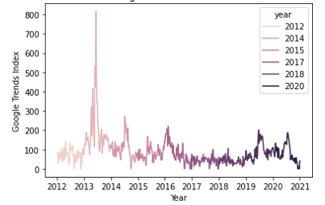
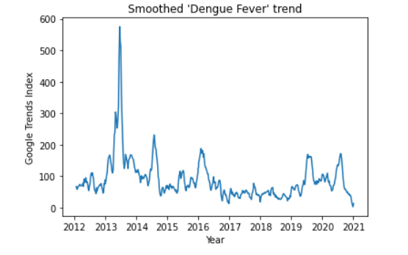
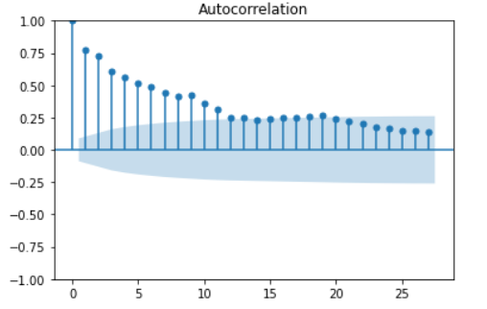
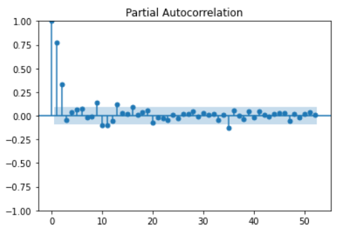
EDA - Time series for Google Trends (“Dengue Fever”)
Notes:
Cue Jason
What Shin did - researched a denormalization algorithm to undo the effect of Google Trends normalization to conduct spatio-temporal analysis. With the denormalised data, we plot the weekly trends in data
How to interpret the ACF and PACF graphs?

Slide 17
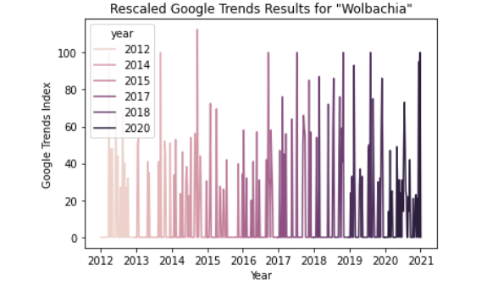
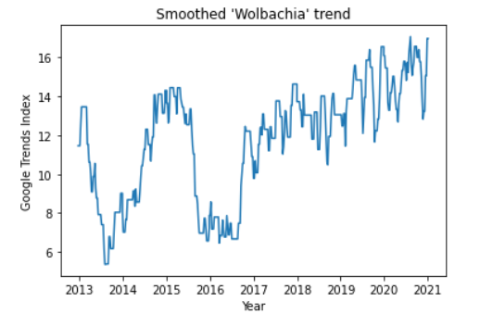
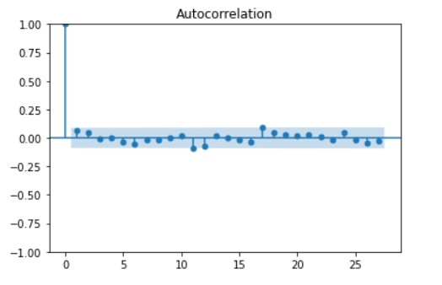
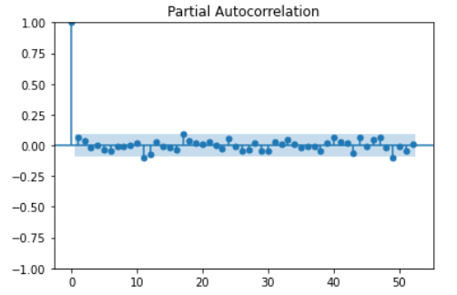
EDA - Time series for Google Trends (“Wolbachia”)
Notes:
Cue Jason

Slide 18
Data Cleaning Steps - Imputing Missing values
NEA dengue cases data¶
This data reflects cases within clusters (defined as at least 2 reported dengue cases) in each geographical region in Singapore
Time period of the data scraped is mid-2013 to 2020
39 unique regions in this dataframe
Dealing with null values: Impute all NaN values with backfill method.
Singapore Weather data¶
Rainfall, Temperature, Wind Speed (mean, max, min)
This was scraped from the web using selenium and gives daily weather data from 2012 to 2020 from 63 weather stations across the country.
Time period: 2012 to 2020
65 Weather Stations in this dataframe
Dealing with null values: 2 tiers
Impute with the mean value from other values from the same weather station, year and month
For those not imputed, to impute with the global mean
Notes:
Likewise for the other keyword, Wolbacchia

Slide 19
Data Cleaning Steps - Merging datasets by towns
Aggregation was used in order to merge the “Weather” and “Total Dengue cases” data
1) One way is to split the whole of Singapore into broad regions i.e. North, South, East, West, Central.
Every town in Total Dengue cases and every Station in Weather is matched to a broad region (North/South/west etc)
Then, we will aggregate the values for each broad region to create the final dataset
We can fit one model on all the regions represented (whole of SG), or run sub-models for each region
2) Another way (preferred**) is to match the list of ‘Weather Stations’ and ‘Towns’ to keep more granular data to have more rows of data for the eventual model
Take only the intersection of the 2 lists of locations. Left with 25 Towns in total.
Many-to-one matching between the 2 lists of locations, for e.g. Tuas, Tuas South and Tuas West stations are all part of 'Tuas' region in the list of towns for the Total Dengue Cases dataframe -> Use Aggegation by Year, Month and Town
Notes:
Likewise for the other keyword, Wolbacchia

Slide 20
Data Dictionary for final cleaned dataset
Shape: 9494 rows, 21 columns
Date range: 2013-W21 to 2020-W45
Column name | Type | Numerical/ Categorical | Description
epi_week_year | str | Numerical | Epi week (e.g. 2020-W45)
start | datetime | Numerical | First date of the epiweek
dengue_cases | int | Numerical | Number of dengue cases in NEA-reported clusters
Year | int | Numerical | Year
Month | str | Categorical | Month of the year
Day | int | Numerical | Day of the month
freq_dengue_gtrends | float | Numerical | Google search trends for keyword “Dengue Fever” (Rescaled)
freq_wolbachia_gtrends | float | Numerical | Google search trends for “Wolbachia” (Rescaled)
Notes:
Cindy

Slide 21
Data Dictionary for final cleaned dataset
Column name | Type | Numerical/ Categorical | Description
total_rainfall | float | Numerical | Weekly mean of average rainfall (mm) for the given Town
rainfall_30min | float | Numerical | Weekly Highest 30 Min Rainfall (mm) for the Town
rainfall_60min | float | Numerical | Weekly Highest 60 Min Rainfall (mm) for the Town
rainfall_120min | float | Numerical | Weekly Highest 120 Min Rainfall (mm) for the Town
temperature_mean | float | Numerical | Weekly Mean Temperature (deg C)
temperature_max | float | Numerical | Weekly Max Temperature (deg C)
temperature_min | float | Numerical | Weekly Min Temperature (deg C)
windspeed_mean | float | Numerical | Weekly Mean Wind Speed (km/h)
windspeed_max | float | Numerical | Weekly Max Wind Speed (km/h)
Town | str | Categorical | Geographical Town in Singapore (e.g. ang mo kio, yishun)
Region | str | Categorical | Geographical Region of Singapore. Options include: North, South, East, West, Central
Notes:
Cindy

Slide 22
Model fitting
One overall model for whole of Singapore
One hot encoded categorical variables: Month, Town
Dropped variables: Region (this is perfectly collinear with Town variable), Year, epi_week_year, start
Train dataset - 80%
Test dataset - 20%
Notes:
Our original thought was to run ARIMA time series modelling for each town (25 towns in total) and/or each region (North, South, East, West).
However, we decided to go back to change to

Slide 23
Baseline Model - Linear Regression
We chose linear regression as our baseline model because there is better model interpretability for each regressor (x variable).

Slide 24
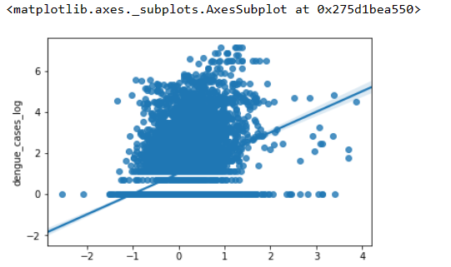
Baseline Model - Linear Regression
Linear Regression has advantage because we are able to see the influence of each factor on the y variable (dengue_cases)
From the graph, the number of dengue cases and the regressors are not linearly related. Hence linear regression model, even with regularization, is limited at predicting number of dengue cases.

Slide 25
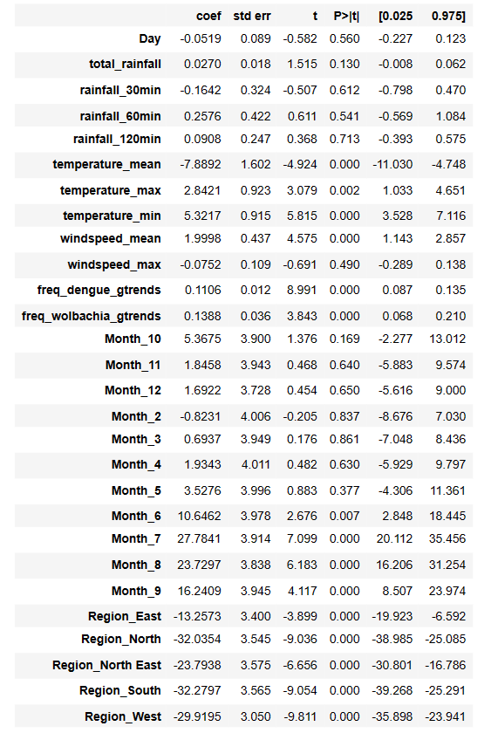
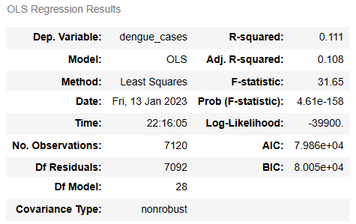
Linear Regression
Accuracy scores
Train score: 0.05987
Test score: 0.05249
(Low scores before log transformation)

Slide 26
Evaluation Metrics for best model
Train and Test accuracy scores
Robust Scaler
Polynomial (degree 2)
 | Parameters | Train score | Test score
Linear Regression (no regularization) | lr__n_jobs: 1 | 0.107 | 0.222
Linear Regression (Ridge) | rd__alpha: 65.0 | 0.217 | 0.237
Linear Regression (Lasso) | la__alpha: 0.005 la__max_iter: 100000 | 0.246 | 0.242
Linear Regression (Elastic Net) | en__alpha: 0.01 en__l1_ratio: 0.8 | 0.237 | 0.228
Random Forest Regressor | rrf__n_estimators: 8 | 0.223 | 0.226
Gradient Boosting Regressor | gb__n_estimators: 330 | 0.324 | 0.312
KNeighbours Regressor | knn__n_neighbors: 6 | 0.112 | 0.114

Slide 27
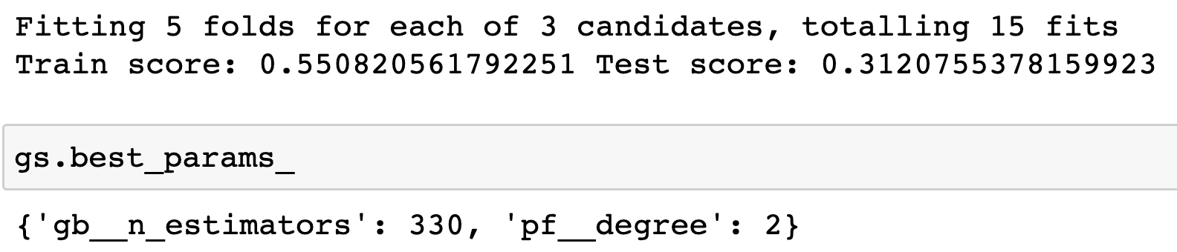
Best Model - Gradient Boost Regression
Steps taken
Run GridsearchCV using Pipelines to determine the best model performance
Log all the numerical y and x values
Robust Scaler
Polynomial (degree 2)
RMSE : 1.246
Notes:
Cindy can replace the screenshot for this pls!

Slide 28
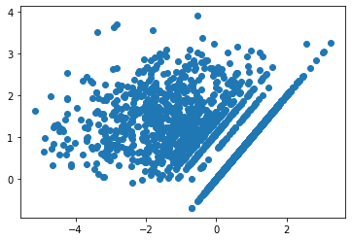
Residual plots
Residual is the difference between y(predicted) and y(train) values
y_test
Residuals

Slide 29


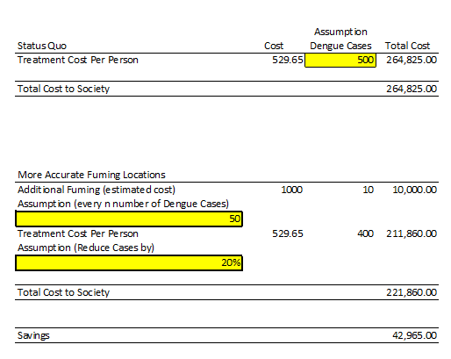
COST BENEFIT ANALYSIS
Cost-Benefit tool for NEA decision makers or pest control companies:
Estimated Cost of Fuming for one neighbourhood
Benefit: Estimated savings on dengue treatment per person
$1000.00
$529.65
Revenue obtained from property rentals
Aggregate treatment cost of dengue patient from a specialist

Slide 30
POSSIBLE IMPROVEMENTS
Model performance could be limited by the following factors
Online availability and cleanliness of data
Lack of subject matter experts to consult, hence we cannot consider whether method of imputation of null values, y variables chosen are in line with current knowledge on dengue spread (and how it affects the general population)

Slide 31
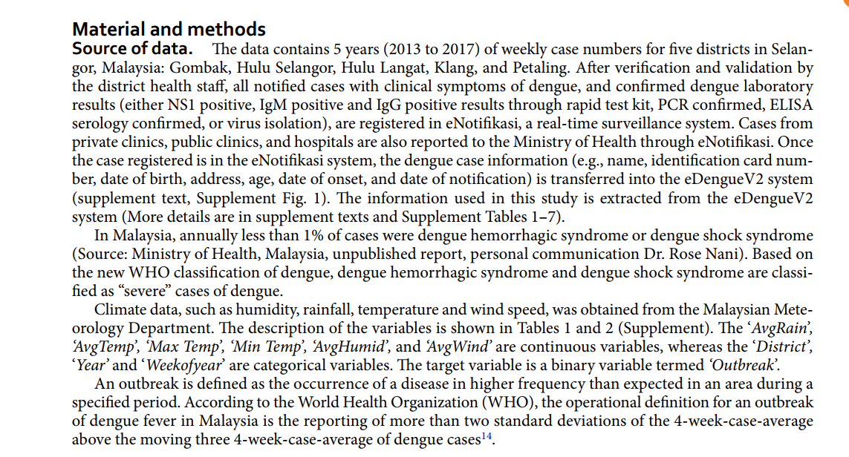
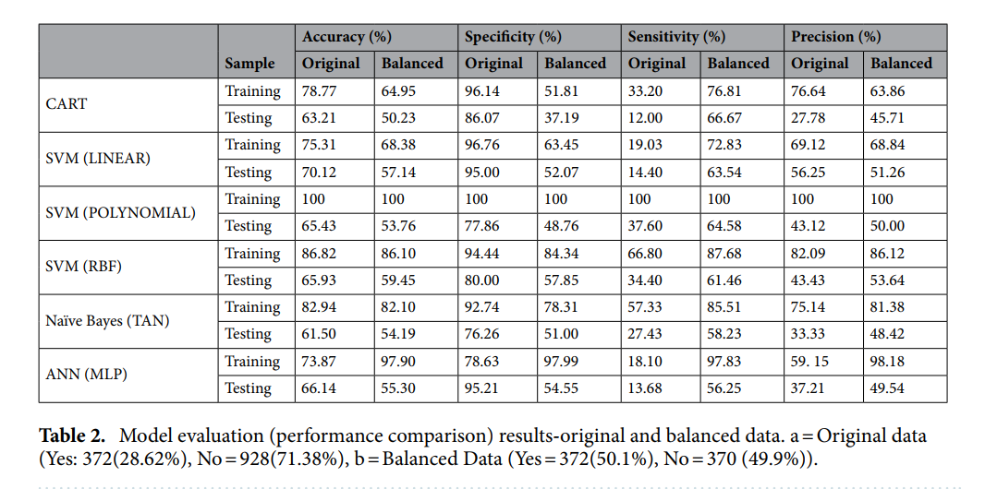
POSSIBLE IMPROVEMENTS
ADAPTED FROM A RESEARCH PAPER ON DENGUE MODELLING IN SELANGOR, MALAYSIA
This model focuses on a classification model to predict “outbreak/no outbreak” based on the WHO definitions of outbreak, using 4-week-case-average above the moving three 4-week-case-average of dengue cases.
It considers an added dimension of time series for engineering the binary y-variable, even though the eventual model was not time-series, but SVM.

Slide 32
THANK YOU

